Slide 1
Gender and Women’s History

Slide 2
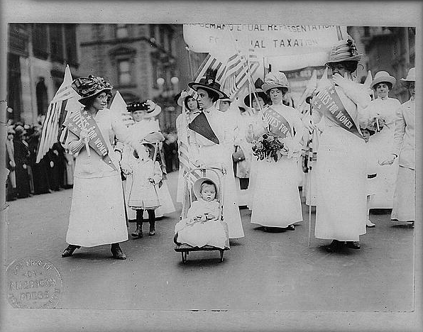
What is gender?
Notes:
Suffrage parade, NYC, 1913

Slide 3
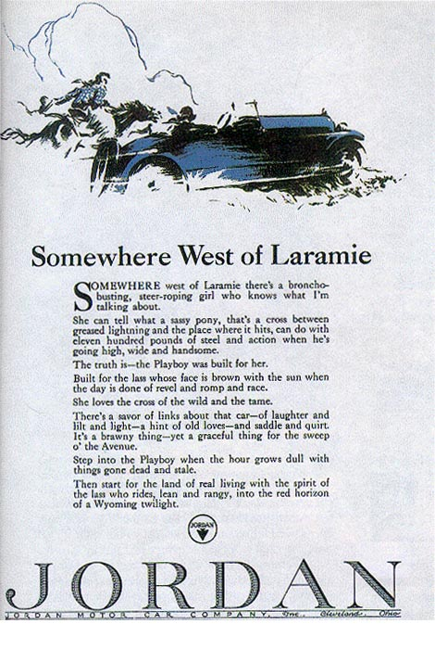

Slide 4
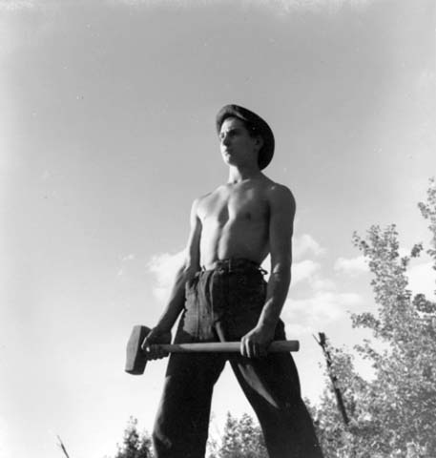
Gender is not another word for woman
Notes:
We Can Take It, CCC photo, Wilfred J. Mead

Slide 5
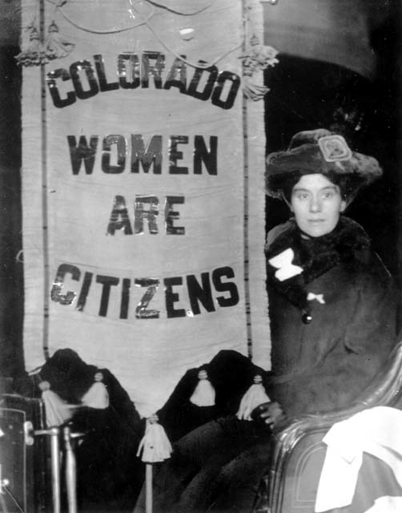

Slide 6
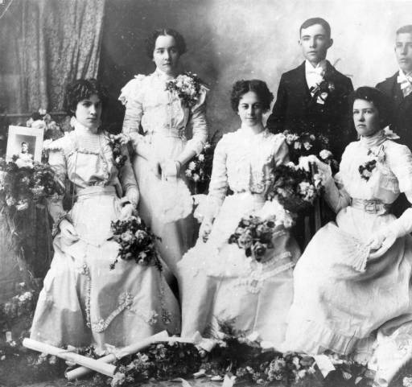
Graduating High School Class Black Hawk High, Black Hawk, Colo. June 1899

Slide 7
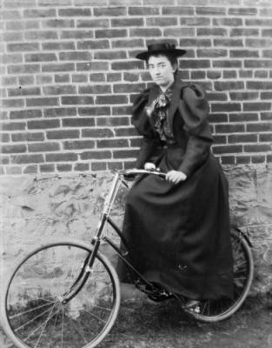
Woman bicyclist, Denver, ca. 1900

